Slide 1
disperse

Slide 2


Slide 3
Indecisive
Scatter, dissipate, spread, disseminate
uN

Slide 4
Adjacent

Slide 5
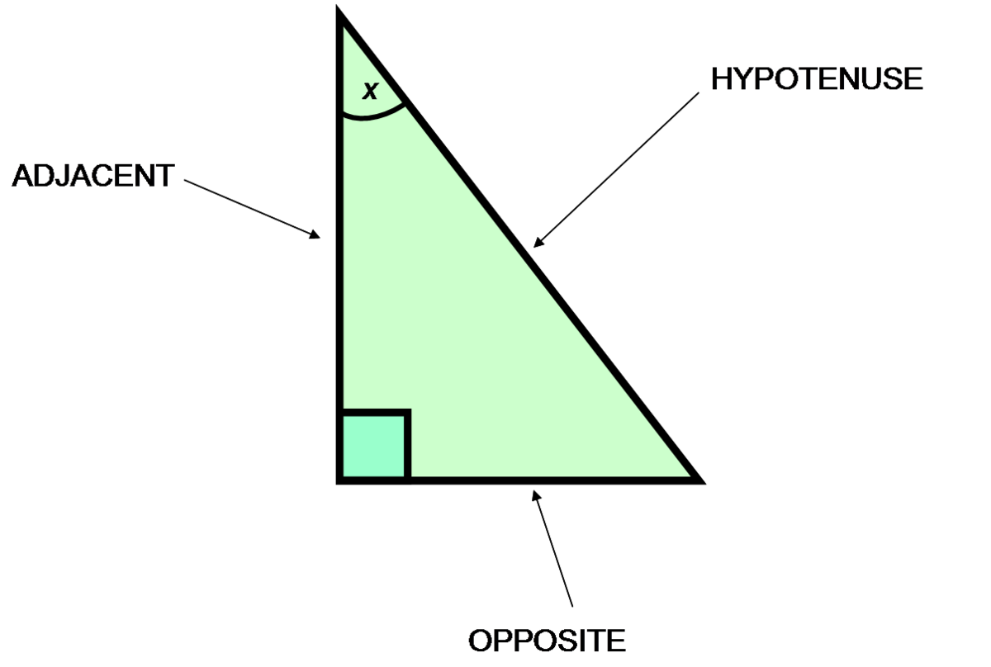

Slide 6
Nearby, neighboring, adjoining

Slide 7
Sequence

Slide 8
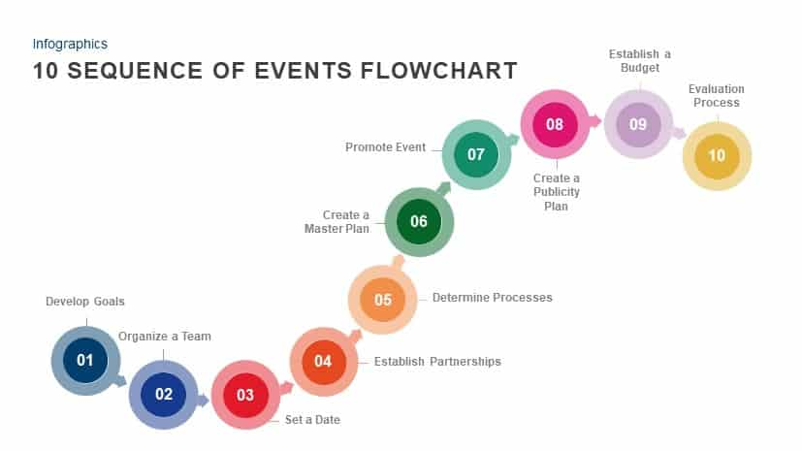

Slide 9
Progression, series, string, succession; order

Slide 10
to decide
Detect

Slide 11


Slide 12
Discover, find, identify, recognize, sense
Indecisive

Slide 13
Flexible

Slide 14


Slide 15
Indecisive
Pliable, bendable, adaptable, adjustable

Slide 16
Surpass

Slide 17


Slide 18
Exceed, outrun, be higher than, excel

Slide 19
Invariable

Slide 20
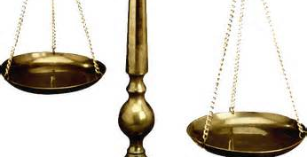

Slide 21
Indecisive
Constant, consistent, unchanging

Slide 22
Dramatic

Slide 23


Slide 24
Indecisive
Striking, significant, impressive

Slide 25
master

Slide 26
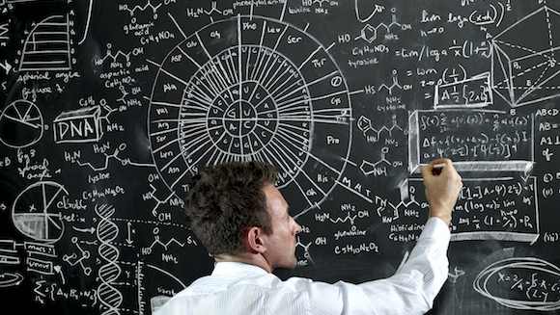

Slide 27
Indecisive
Learn thoroughly, learn, acquire; control, manage

Slide 28
assimilate

Slide 29


Slide 30
Indecisive
Absorb, take in, digest

Slide 31
overwhelming

Slide 32
Indecisive
Powerful, enormous, compelling, tremendous

Slide 33
curious

Slide 34
Indecisive
Inquisitive, questioning, inquiring; strange, mysterious, extraordinary

Slide 35
Alteration

Slide 36
Indecisive
change, modification

Slide 37
Consequence

Slide 38
Indecisive
Result, effect, ramification, outcome; importance, significance

Slide 39
Deceive

Slide 40
Indecisive
Mislead, delude, cheat

Slide 41
ample

Slide 42
Indecisive
Sizable, large, spacious, vast; plentiful, abundant, more than enough

Slide 43
resilient

Slide 44
Indecisive
Quick to recover, easy to recover

Slide 45
detach

Slide 46
Indecisive
Separate, disconnect, disengage

Slide 47
Account

Slide 48
Indecisive
Description, report, narrative

Slide 49
equilibrium

Slide 50
Indecisive
Balance, symmetery

Slide 51
surmise

Slide 52
Indecisive
Infer, guess, speculate, suspect

Slide 53
unsuitable

Slide 54
Indecisive
Inappropriate, unfit, improper

Slide 55
imaginative

Slide 56
Indecisive
Creative, inventive, original

Slide 57
imposing

Slide 58
Indecisive
Impressive, striking

Slide 59
Vitality

Slide 60
Indecisive
Energy, liveliness, vigor

Slide 61
Vehicle

Slide 62
Indecisive
Means, medium, instrument

Slide 63
Hitherto

Slide 64
Indecisive
Previously, so far, until now

Slide 65
Plague

Slide 66
Indecisive
Cause a problem for, bother, annoy

Slide 67
Domain

Slide 68
Indecisive
Area, field

Slide 69
Indifferent

Slide 70
Indecisive
Uninterested, unconcerned, careless

Slide 71
champion

Slide 72
Indecisive
Support, promote, advocate, endorse

Slide 73
deteriorate

Slide 74
Indecisive
Get worse, degenerate

Slide 75
assault

Slide 76
Indecisive
Attack, aggress, assail

Slide 77
Appropriate

Slide 78
Indecisive
Suitable, proper, applicable

Slide 79
Adept

Slide 80
Indecisive
Skillful, proficient, deft, adroit

Slide 81
indeed

Slide 82
Indecisive
In truth, in fact

Slide 83
Pursuit

Slide 84
Indecisive
Interest, pastime, hobby

Slide 85
Incite

Slide 86
Indecisive
Stimulate, provoke, inflame, spur

Slide 87
Guarantee

Slide 88
Indecisive
Ensure, secure, warrant

Slide 89
Prosperity

Slide 90
Indecisive
Economic well-being, wealth, fortune

Slide 91
Primarily

Slide 92
Indecisive
Mostly, mainly, chiefly, originally, at first, initially

Slide 93
Erupt

Slide 94
Indecisive
Explode, burst, blow up

Slide 95
trace

Slide 96
Indecisive
Evidence, vestige, imprint, mark

Slide 97
Prestigious

Slide 98
Indecisive
Highly regarded, esteemed, respected

Slide 99
Shape

Slide 100
Indecisive
Affect, form, influence

Slide 101
Inflict

Slide 102
Indecisive
Cause, administer, exact

Slide 103
portion

Slide 104
Indecisive
Part, segment, fragment

Slide 105
Coincidence

Slide 106
Indecisive
Chance happening

Slide 107
Propel

Slide 108
Indecisive
Push, force, drive, impel

Slide 109
Throughly

Slide 110
Indecisive
Completely, entirely

Slide 111
Contemplate

Slide 112
Indecisive
Consider, ponder

Slide 113
Unethical

Slide 114
Indecisive
Improper, immoral

Slide 115
Replicate

Slide 116
Indecisive
Reproduce, copy, duplicate

Slide 117
Hasty

Slide 118
Indecisive
Hurried, rushed

Slide 119
representative

Slide 120
Indecisive
Indicative, typical, exemplary

Slide 121
range

Slide 122
Indecisive
Scope, spectrum, extent

Slide 123
Quiz 1. (b) 2. (j) 3. (h) 4. (e) 5. (g) 6. (i), 7. (d), 8. (f) 9. (a), 10. (c)
Resilient
Assimilate
Adept
Appropriate
Contemplate
Adjacent
Dramatic
Champion
Trace
Surpass
Striking, significant, impressive
Exceed, outrun, be higher than
Evidence, vestige, imprint
Consider, ponder,
Quick to recover, easy to recover
Absorb, take in, digest
Support, promote, advocate
Nearby, neighboring, adjoining
Skillful, proficient, deft
Suitable proper, applicable

